Slide 1
MAAI902 ASSESSMENT 2
Automated Sentiment Analysis
Deep Learning for Large-Scale Content Moderation
Presented by: Bin Huang - 8391865
Notes:
Good evening. My name is Bin Huang, and this is my MAAI902 Assessment 2 submission. The project is called Automated Sentiment Analysis: Deep Learning for Large-Scale Content Moderation. Over the next few minutes I'll walk through the problem, the pipeline I built, the results, and what I learned from where the model fails.

Slide 2
The Moderation Bottleneck
The Problem: Thousands of long-form reviews daily. Manual triage fails at scale.
The Dataset: IMDB Movie Reviews (50K records).
The Goal: Binary classification (Positive vs Negative).
Why it Matters: Automated semantic understanding replaces brittle keyword filters.
Notes:
Platforms like IMDb, app stores, and e-commerce sites receive thousands of long-form reviews every day. Manual moderation at that scale is impossible — it's slow, it's expensive, and it's inconsistent between reviewers. My problem is a sub-problem of that: automatically classify each review as positive or negative so that moderation and analytics can be triaged. I used the IMDB Movie Reviews dataset, 50,000 records, binary labels. The reason this needs NLP and not a keyword filter is that sentiment is expressed implicitly. I'll show you an example of exactly that failure mode in a few slides.

Slide 3
Dataset Integrity & Balance
49,582
50/50
Clean Unique Reviews
Perfect Class Balance
418 duplicates removed.
24,884 Positive | 24,698 Negative
Hardware Constraint: Truncated at 512 tokens max.
Notes:
Before training, I loaded the dataset and found 50,000 rows across two columns — review text and sentiment label. I ran a duplicate check and found 418 exact duplicate reviews. Retaining those would cause data leakage, because the same review could appear in both train and test, so I removed them. That left 49,582 unique reviews. After deduplication the classes were still effectively balanced — 24,884 positive against 24,698 negative — so no class weighting was needed. One constraint I want to flag now because I return to it later: DistilBERT caps sequences at 512 tokens, so long reviews were truncated.

Slide 4


What I Built
Baseline Model
Core Architecture
TF-IDF + LinearSVC
DistilBERT (uncased)
• 10,000 max features.
• Colab T4 GPU.
• 1-2 n-grams.
• Mixed precision (fp16).
• Fast, interpretable floor.
• 1 epoch, sequence classification head.
Notes:
I built two models. First, a baseline: TF-IDF vectorizer with 10,000 features and 1-2 n-grams, feeding a Linear Support Vector Classifier. That's cheap, fast, and interpretable — I wanted a performance floor. If a transformer couldn't meaningfully beat a word-counting baseline, the extra cost wouldn't be justified. Second, the core model: DistilBERT, uncased, fine-tuned for sequence classification on a Colab T4 GPU with mixed precision, one epoch. I chose DistilBERT over full BERT because it keeps roughly 97 percent of BERT's performance at 60 percent the inference cost — that trade-off matters for a system that would run at scale.

Slide 5

The Headline Result
DistilBERT
Baseline (TF-IDF)
0.93
0.90
Macro-F1 Score
Macro-F1 Score
Transformers capture semantic nuance.
Deep learning beats strict lexical word-counting.
Notes:
The baseline hit a Macro-F1 of 0.90. DistilBERT hit 0.93. A three-point absolute gain over a highly optimised SVM is meaningful in sentiment analysis — it validates the architectural choice. The transformer's self-attention captures semantic relationships that word counting misses. That said, I want to be clear that a 0.90 baseline is unusually strong, and the reason is that IMDB reviews contain a lot of highly polarised vocabulary — 'masterpiece' and 'garbage' do most of the work. On harder, more ambiguous text the gap would likely be larger.

Slide 6
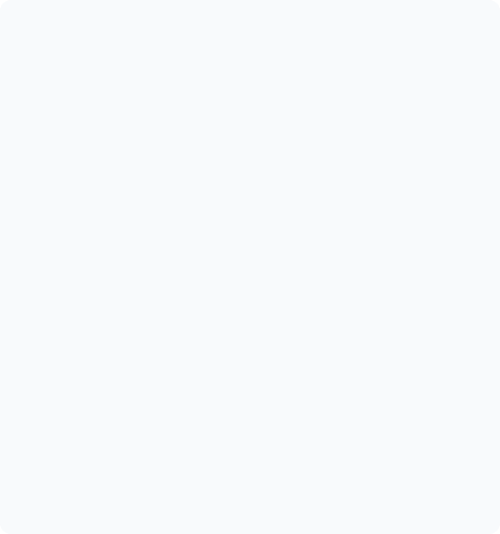
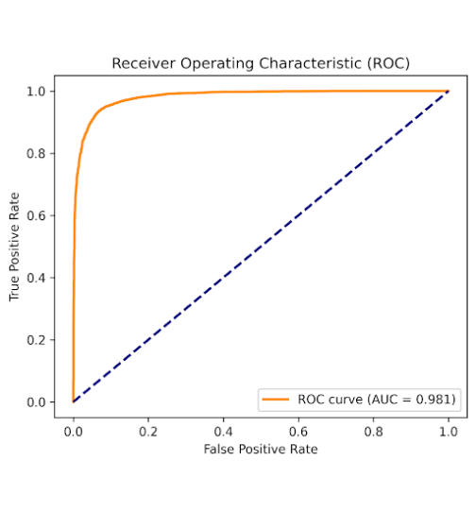
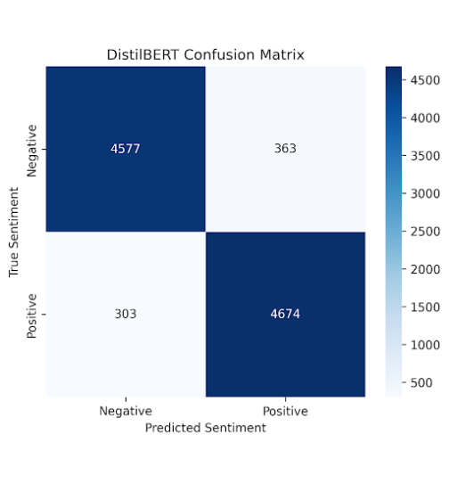
Performance Visualization
Notes:
Two diagnostics. Left: the ROC curve — AUC of 0.981, which shows strong separability across all decision thresholds, not just the default. Right: the confusion matrix. 4,577 true negatives, 4,674 true positives, 363 false positives, 303 false negatives. The errors are near-symmetric — the model isn't biased toward either class. That symmetry is important, because a lopsided matrix would have suggested a class-prior problem, and I'd need to address it in the ethics section.

Slide 7

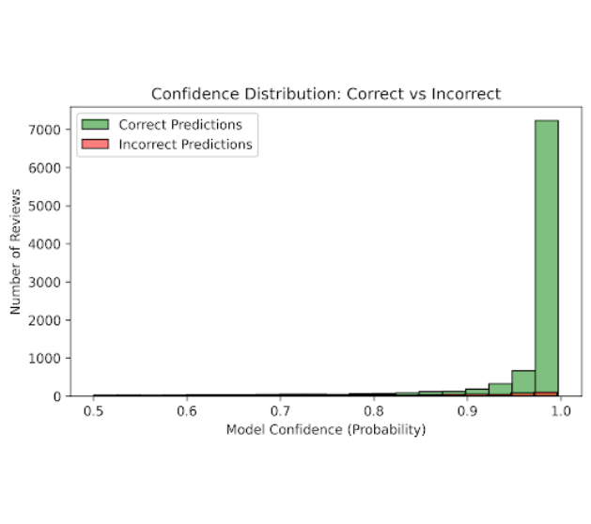
Confidence Calibration
High Certainty: Correct predictions skew heavily toward 95%+ confidence.
Ambiguity Threshold: Errors cluster in the 0.50 - 0.70 confidence range.
Routing Logic: Ambiguous scores can trigger human review.
Notes:
This slide is the one that changed my design. I plotted confidence for correct versus incorrect predictions. Correct predictions cluster hard above 0.95 — that's fine. But look at the red bars: incorrect predictions also cluster well above 0.9. That means the model is overconfident. It gets things wrong, and it gets them wrong confidently. For a downstream routing system, that's more dangerous than a low-confidence error, because a confidently wrong prediction would sail straight through any naive confidence threshold. So my recommendation is that these scores are used as relative signals for triage, not as calibrated probabilities. Calibration via temperature scaling is listed in future work.

Slide 8
Error Analysis: Why the Model Fails
The 512-Token Horizon
Mixed Sentiment & Sarcasm
False Positive (Conf: 0.95)
False Negative (Conf: 0.66)
Start: "Although its plot is taken from history..."
End (Word 628): "...Even seen as erotica it is second-rate. 4/10"
"This isn't exactly a great film, but I admire the writers and director for trying something a little different..."
Model heavily weights early negative tokens and misses the positive pivot.
Truncation forces the model to guess without reading the final verdict.
Notes:
Two failure modes I found by reading the misclassified examples. First, mixed sentiment and sarcasm. This review begins 'This isn't exactly a great film' and then pivots positive. The model weighted the early negative tokens heavily and missed the pivot — you can see it was only 0.66 confident, so a threshold would have caught this one. Second, the 512-token truncation. This review is 628 words. The author delivers their actual verdict — 'second-rate, 4 out of 10' — in the final sentence, which was truncated. The model never saw it. That false positive came out at 0.95 confidence. It was sure, and it was wrong, because it hadn't read the end. That's the overconfidence problem from the previous slide, caused by an architectural limitation.

Slide 9



The Ethical Problem
Sociodemographic Bias Pretrained weights penalize non-standard internet dialects.
Automation Censorship False negatives unfairly silence constructive criticism.
Data Provenance Historical text distribution diverges from modern platform slang.
Notes:
Three ethical risks I addressed in the report. First, sociodemographic bias: pretrained models absorb the biases of their training corpora and can penalise non-standard English, AAVE, or non-native phrasing. My mitigation is disaggregated bias evaluation across dialect probes before any live deployment. Second, automation censorship: a false negative could silence legitimate criticism. My design treats the classifier as a routing aid, not an autonomous gatekeeper — ambiguous-confidence predictions go to a human moderator. Third, data provenance: the IMDB dataset was scraped from historical film discussions and has drifted from modern platform discourse. My mitigation is drift monitoring with retraining triggers, documented in the report.

Slide 10

Conclusion & Verdict
DistilBERT provides a scalable semantic upgrade over TF-IDF.
However, token limits and sarcasm create fatal blindspots. This pipeline is a routing aid, never an autonomous gatekeeper.
Human-in-the-loop review remains strictly required.
Notes:
To sum up. DistilBERT provides a genuine semantic upgrade over TF-IDF — 0.93 against 0.90 Macro-F1, with a three-point margin that's meaningful for sentiment classification. But the error analysis shows two fatal blind spots: token truncation, which caused high-confidence failures, and sarcasm, which caused low-confidence failures. Together they argue for the same conclusion: this pipeline is a routing aid, never an autonomous gatekeeper. Human-in-the-loop review remains strictly required, and confidence scores — because they're uncalibrated — are surfaced so moderators can override any prediction. Thank you. I'm happy to take questions.

Slide 11
Thank You
MAAI902 Assessment 2

